Slide 1
Social Story: Swimming Lessons at Splash’s Clyde

Slide 2
I am going to Splash’s for my swimming lesson.

Slide 3
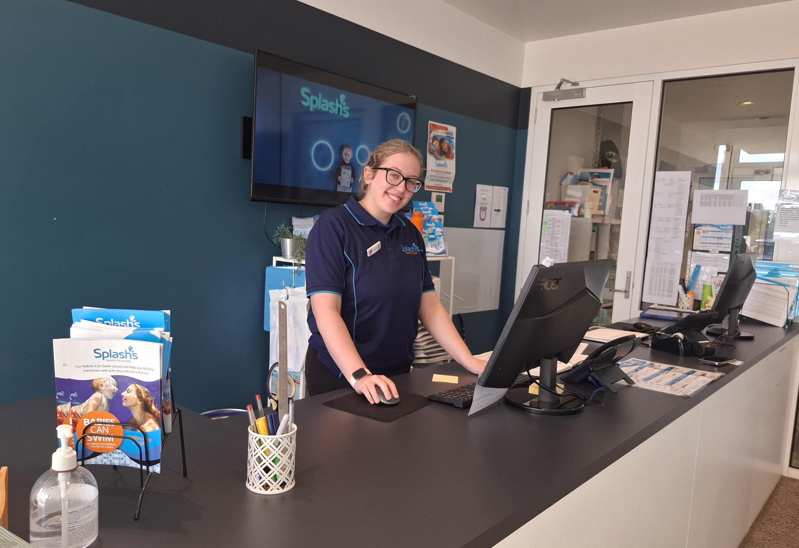
When I arrive I will see people who work at Splash’s.

Slide 4
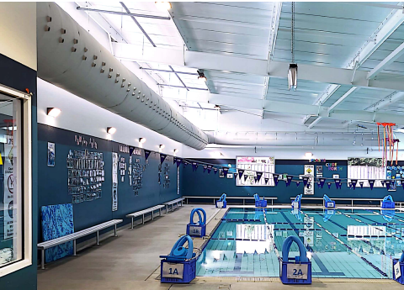
I will sit down on a bench until it is time for my class.

Slide 5
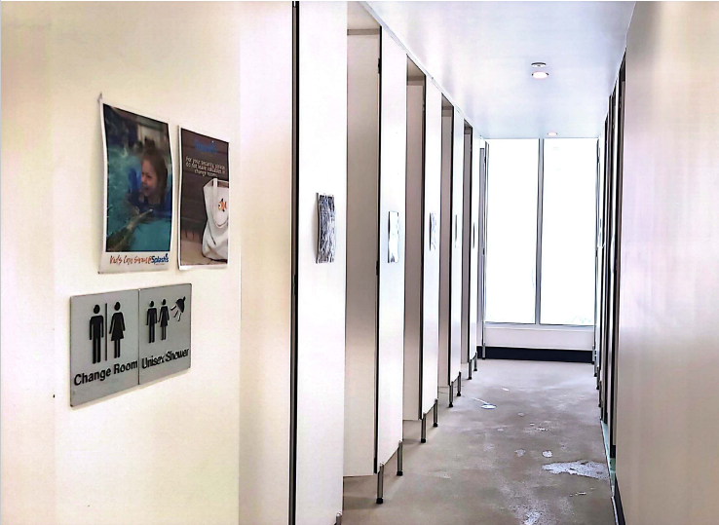
There are spaces where I can get changed.

Slide 6
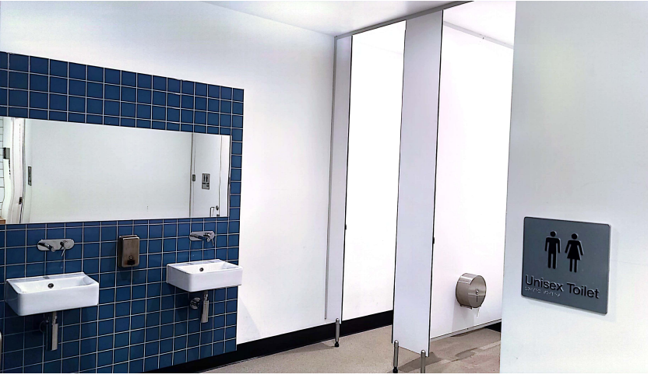
There are toilets near the change rooms.

Slide 7
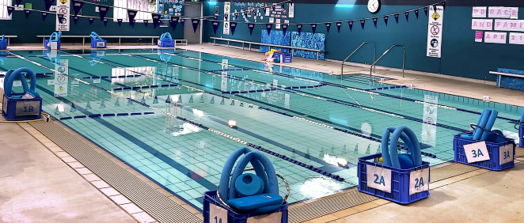
My swimming lesson will take place in the pool.
I walk when I am near the pool to be safe.

Slide 8
My swimming teacher will wear a blue rash vest.
My swimming teacher will meet me at the space where I will have my swimming lesson.

Slide 9
My swimming teacher will show me how to enter the water safely.
My swimming teacher will show me how to paddle, blow bubbles, float and kick in the water. It will be fun!

Slide 10
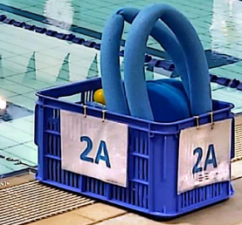
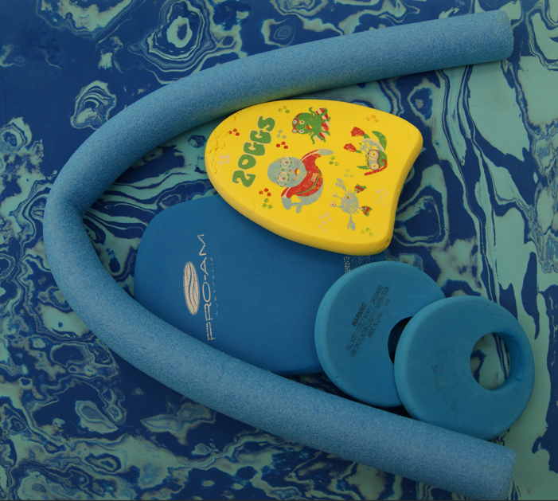
I might use a noodle, kickboard or other equipment during my swimming lesson.

Slide 11
It can be noisy at the pool.
I can wear ear plugs in the water.
I can take a break in a quiet place with my parent or care giver.

Slide 12
After my lesson I will dry off with a towel. I can wear my swim wear home or I can change into dry clothes.

Slide 13
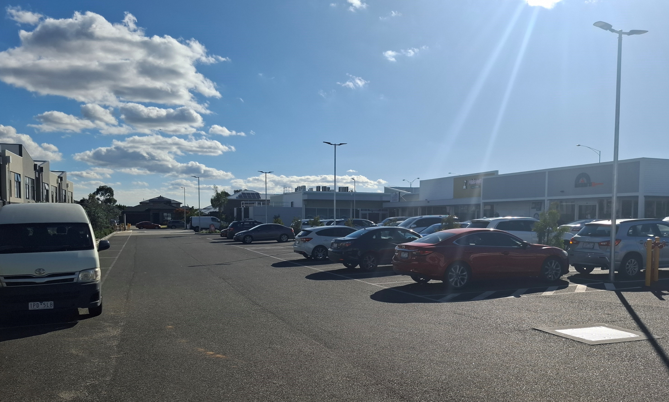
My lesson has finished and it is time to leave. I will walk outside.

