Slide 1
Social Story: School Swimming at Splash’s Clyde

Slide 2
I am going to Splash’s for a swimming lesson.

Slide 3
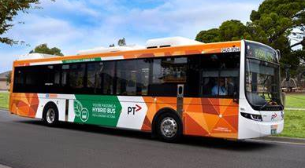
I will travel to Splash’s on a bus.

Slide 4
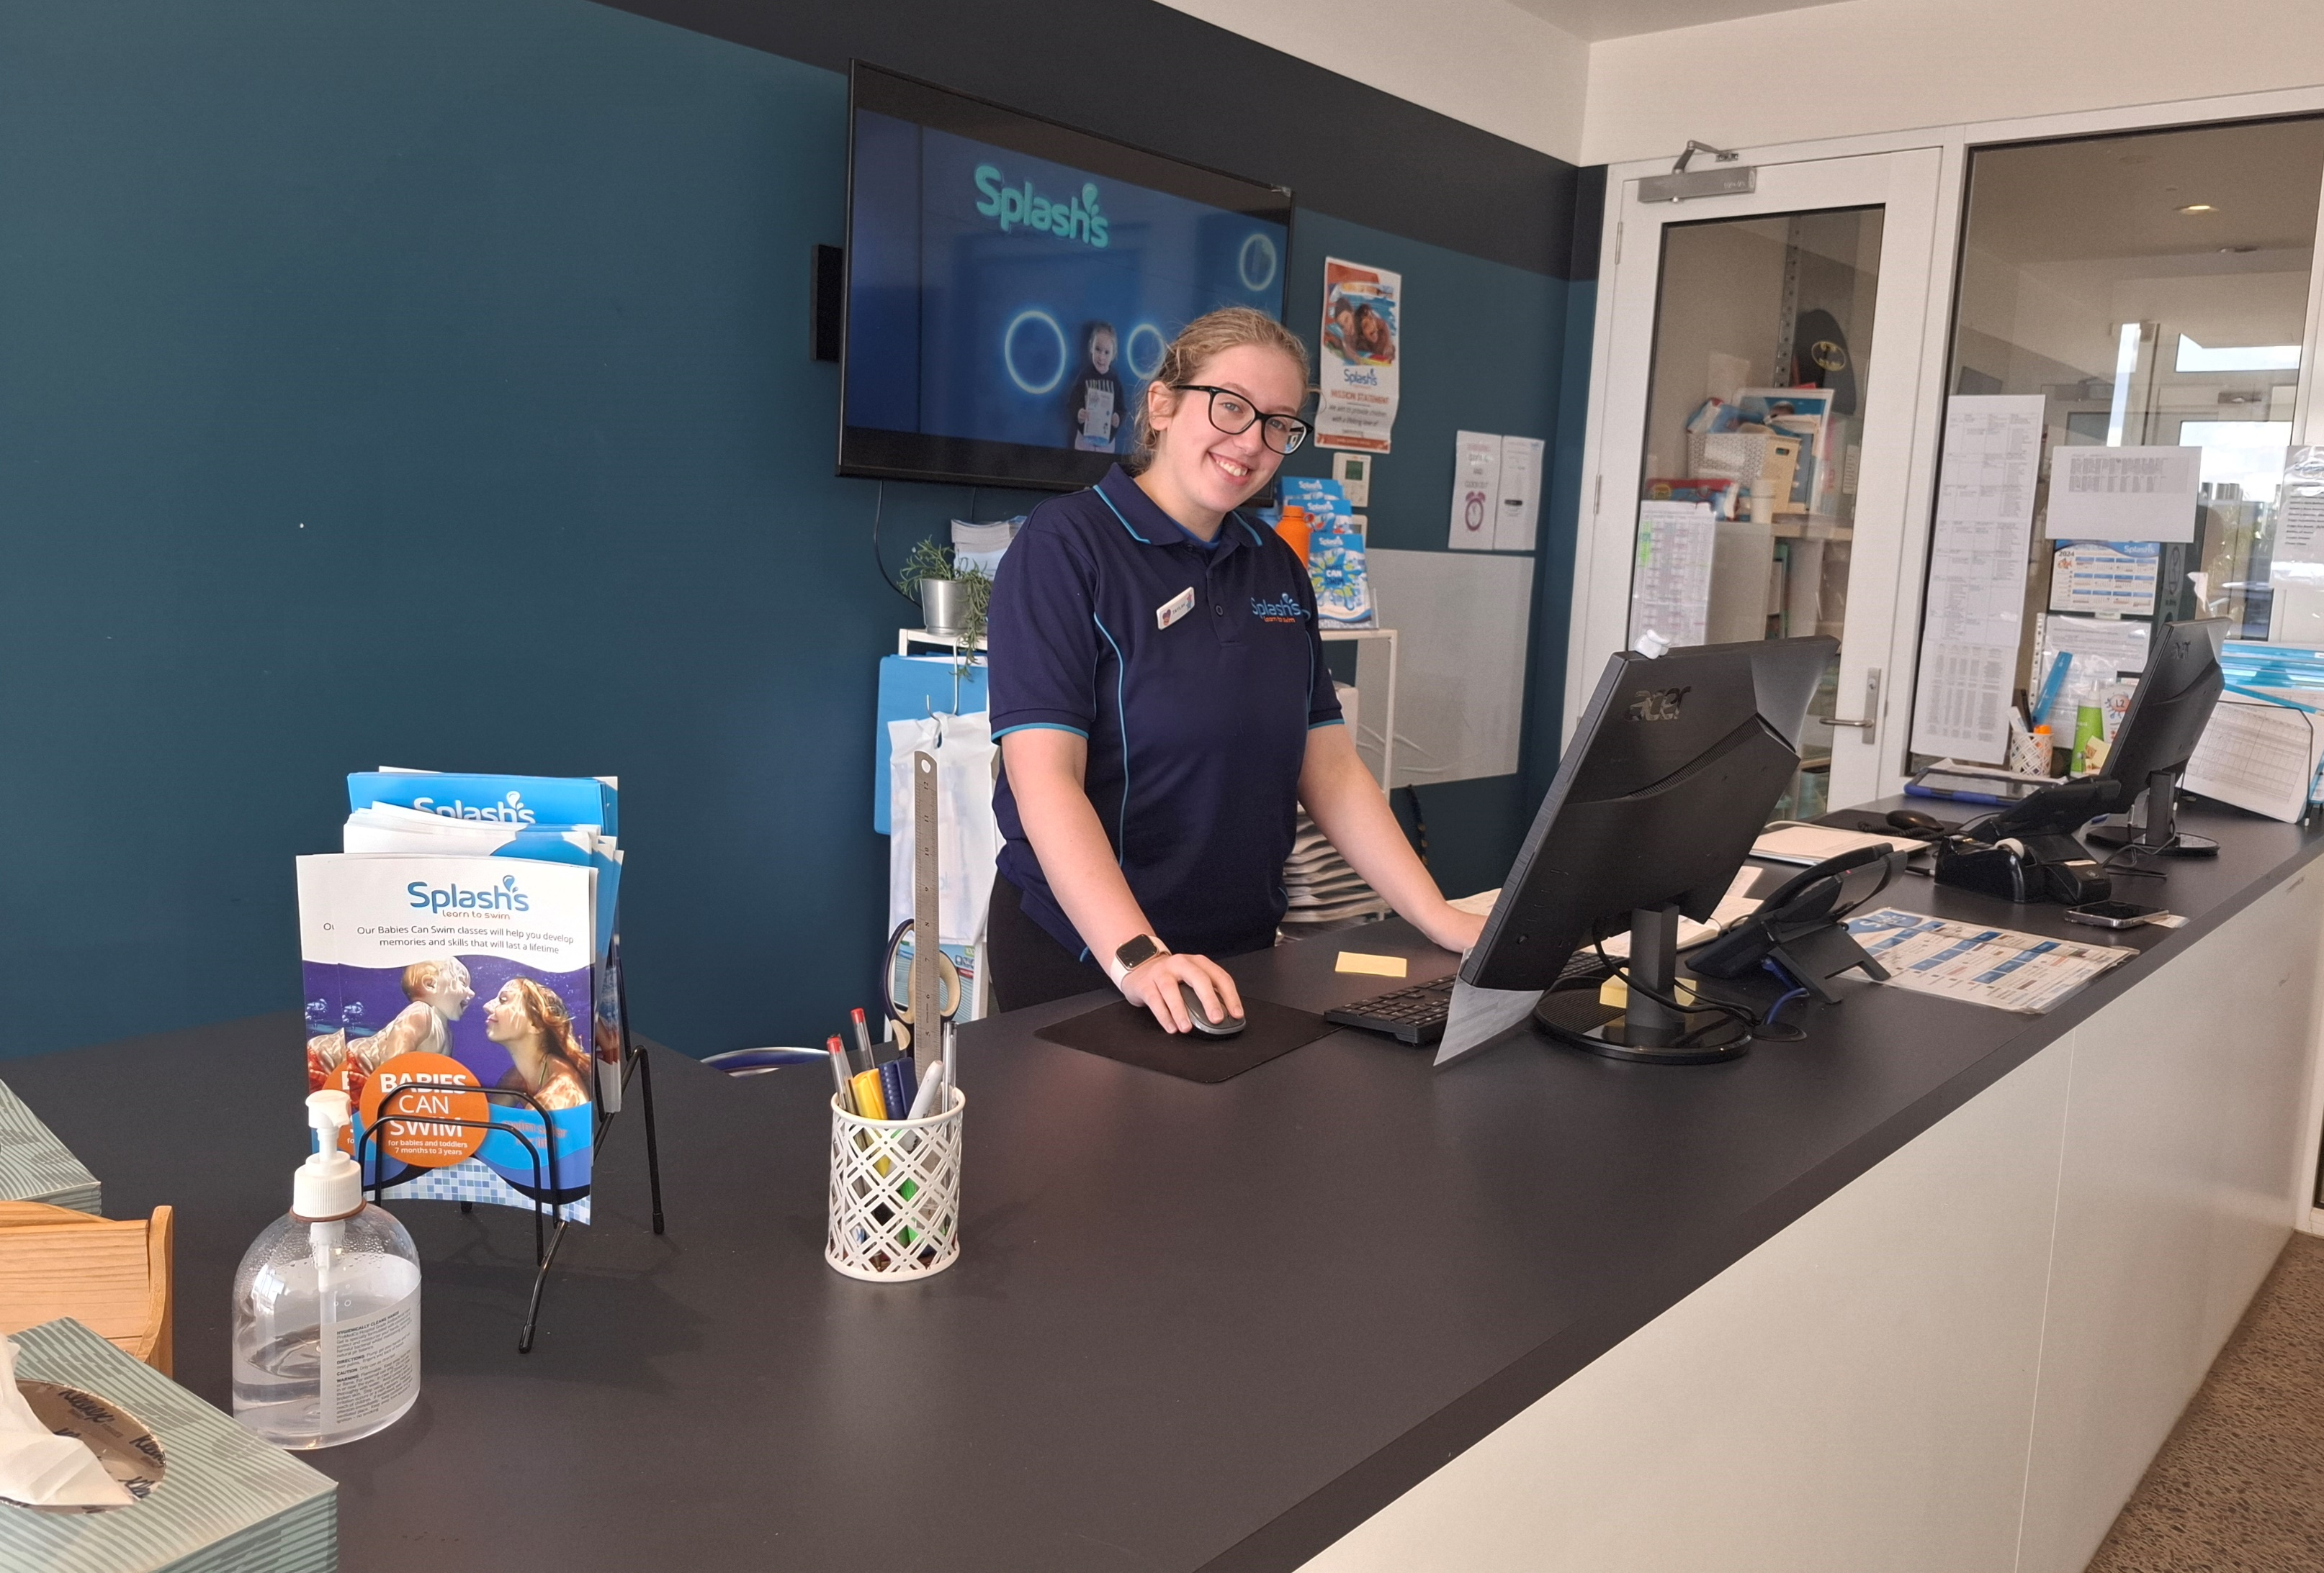
When I arrive I will see people who work at Splash’s.

Slide 5
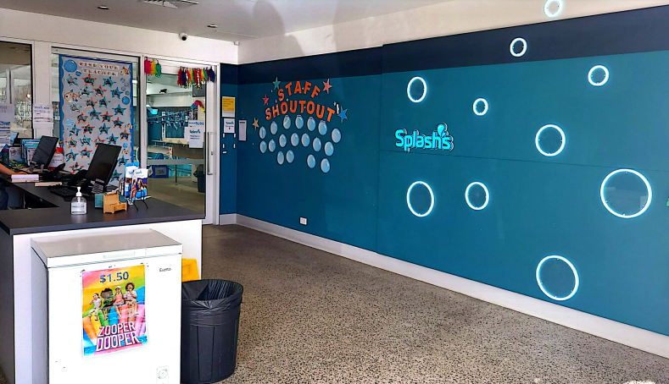
I will sit down until it is time to change into my swim wear.

Slide 6
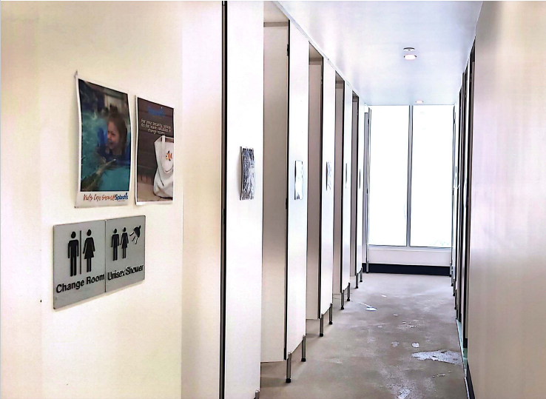
There are spaces where I can get changed.

Slide 7
I will have a swimming bag.
There will be a towel in my swimming bag.
I will take my towel out of my swimming bag.

Slide 8
I will take school uniform off and put it in my swimming bag.

Slide 9
I will swim in a group with other children.
After changing into swimwear I will sit in a space near the colour for my group.
SC PHOTO NEEDED of waiting area with class colours displayed

Slide 10
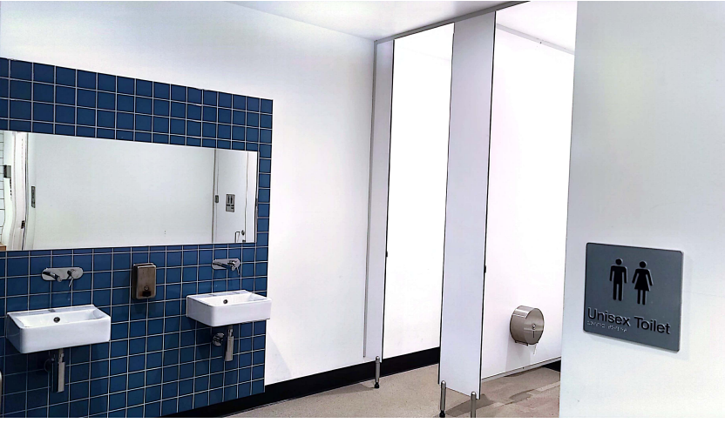
There is a toilet.
My school teacher will take me there if I need to go.

Slide 11
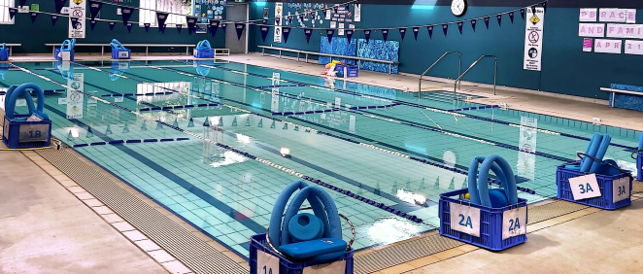
My swimming lesson will take place in the pool.
I walk when I am near the pool to be safe.

Slide 12
My swimming teacher will wear a blue rash vest.
My swimming teacher will take me to the space where I will have my swimming lesson.

Slide 13
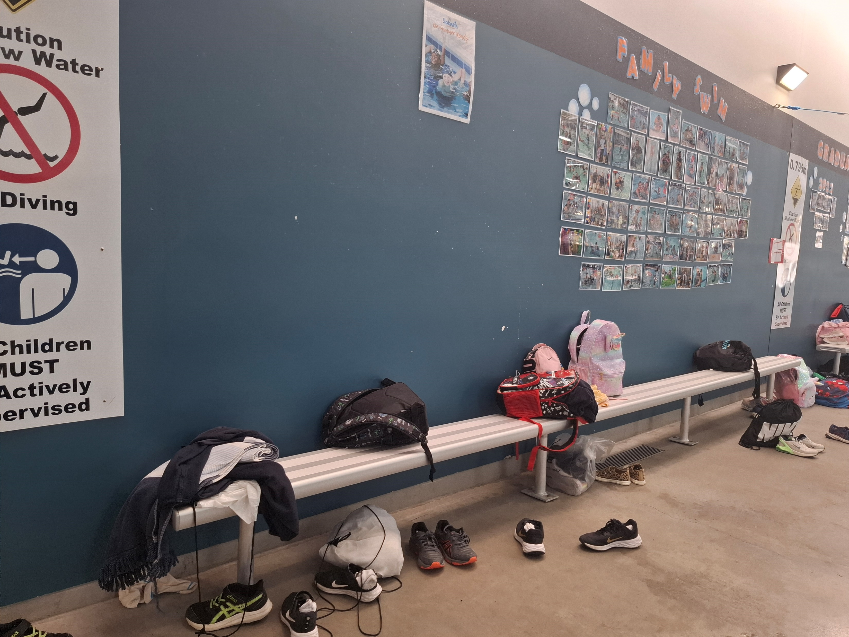
I place my swimming bag on a bench to keep it safe and dry while I am swimming.

Slide 14
My swimming teacher will show me how to enter the water safely.
My swimming teacher will show me how to paddle, blow bubbles, float and kick in the water. It will be fun!

Slide 15
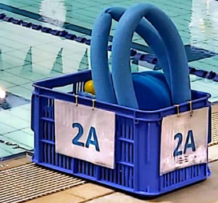
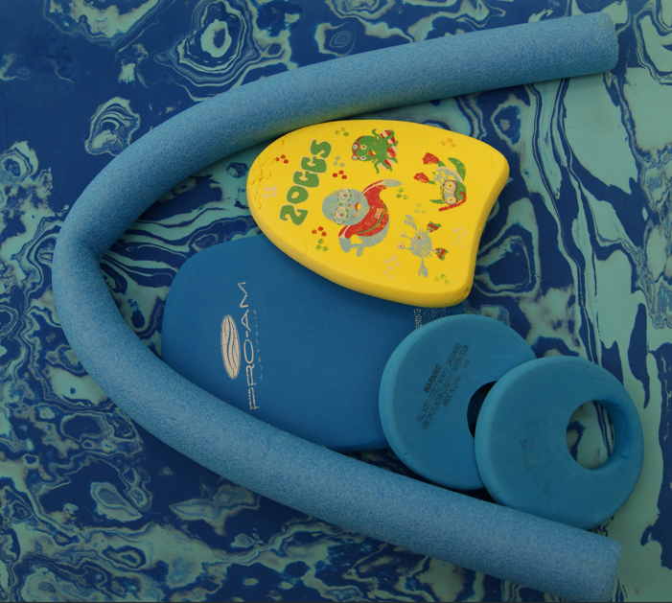
I might use a noodle, kickboard or other equipment during my swimming lesson.

Slide 16
It can be noisy at the pool. I can wear ear plugs in the water. I can take a break in a quiet place with my school teacher.

Slide 17
When my lesson is finished my swimming teacher will take me to my school teacher.

Slide 18
I will dry off and change into my school uniform in the changeroom.
I will put my wet swimwear and towel in my swimming bag.

Slide 19
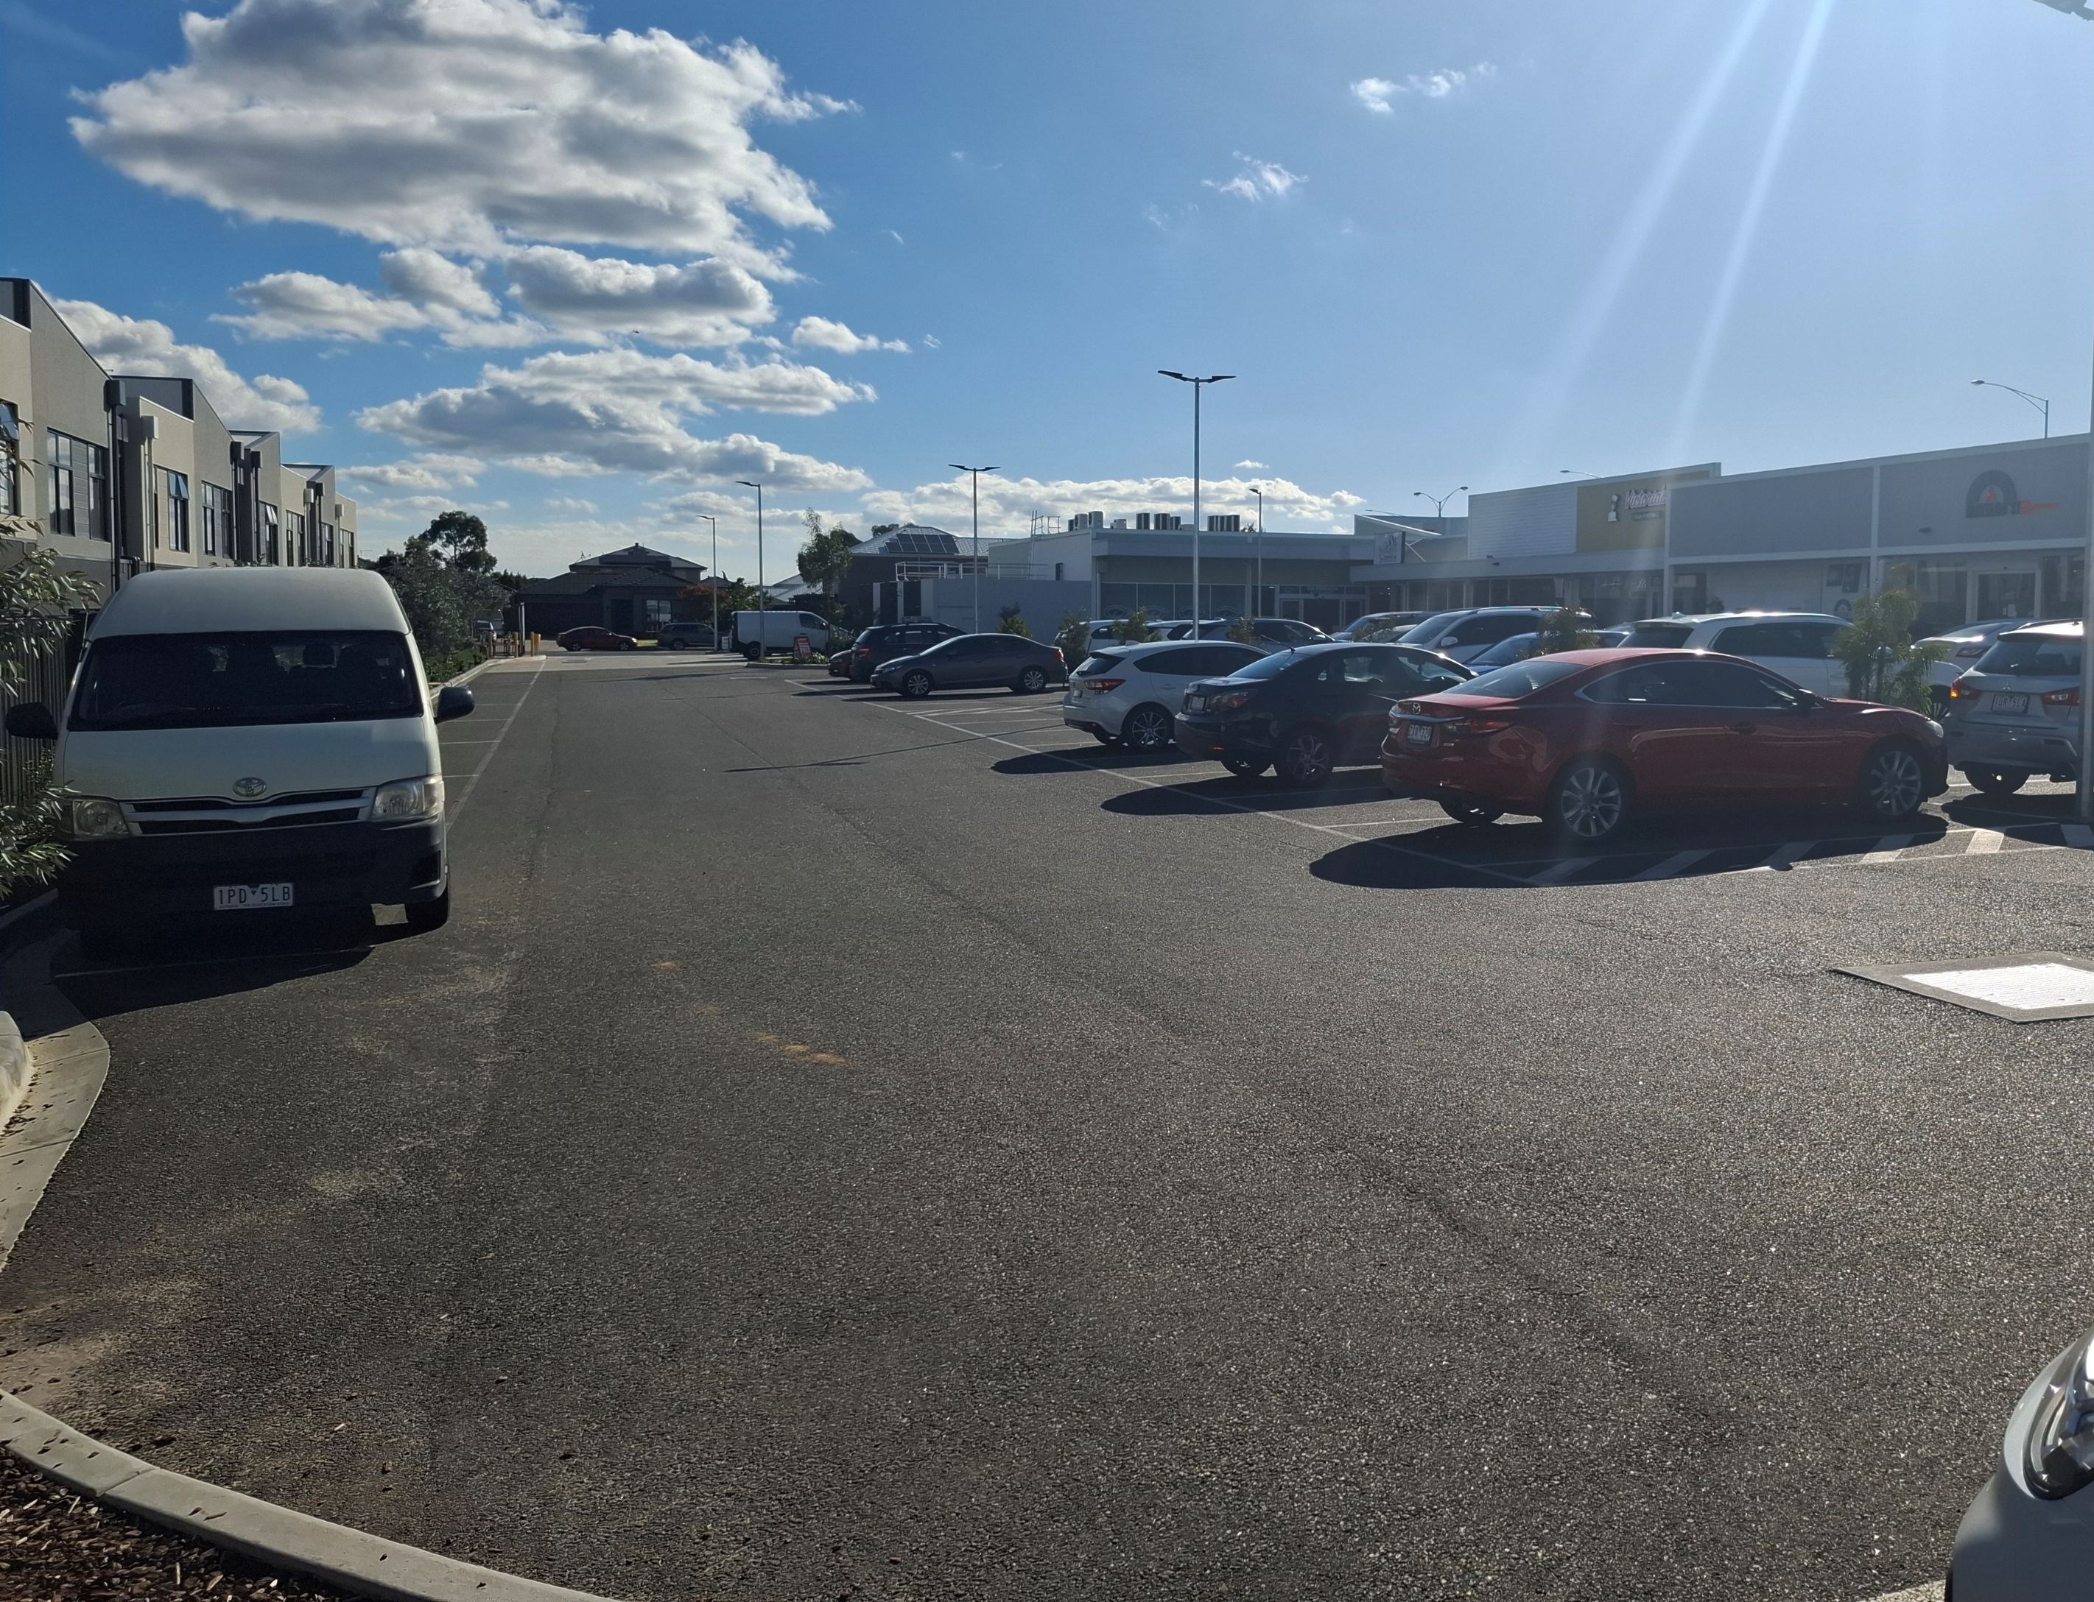
I will wait with my school teacher until it is time to leave.
I will walk outside to the bus.

